Slide 1
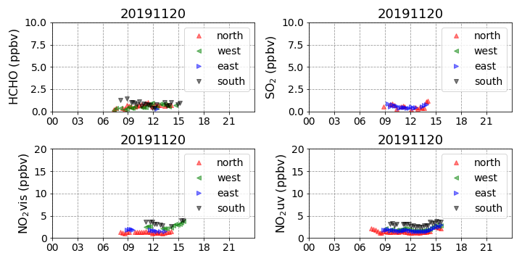
Trace Gas

Slide 2
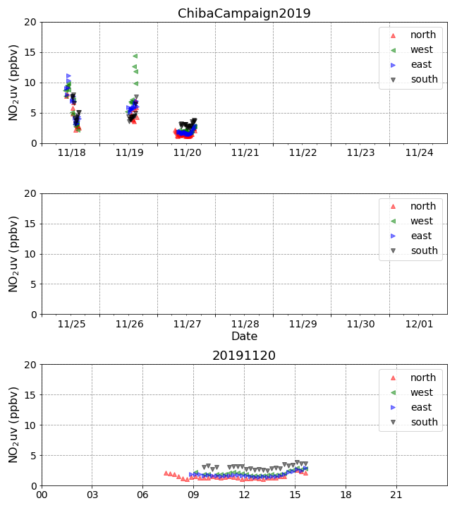
NO₂ time series

Slide 3
NO₂ time series
hour
South is higher than North.
It seems to be greatly influenced by the factory on the south side.

